Slide 1
How to find data set and fairness practices
Sayak Paul
Deep Learning Associate at PyImageSearch
Explore ML Academy, Hyderabad (September 14, 2019)
Notes:
Howdy champs! How are you all?
I am Sayak. I am a deep learning associate at PyImageSearch where I combine the beautiful world of computer vision with deep learning.
We know about the lovely machine learning partnership, right? Data + Model? I will be talking about the first part i.e. data. I will be discussing several ways to gather the dataset for a machine learning project including some best practices.

Slide 2
Agenda
Why is collecting a good dataset important?
The process of data preparation
Collect raw data
Identify features and label sources
Select sampling strategy
Data splitting
Incorporating fairness practices
Guiding lights
sayak.dev
Notes:
Here’s a quick agenda of the talk. I really hope to be crisp and quick.

Slide 3
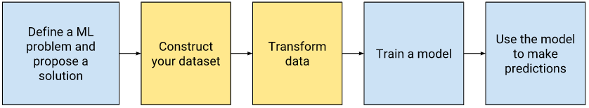
The typical machine learning workflow
Source
sayak.dev
Notes:
Here are the highly summarized steps that involved in a typical machine learning project - problem definition and framing which we discussed a while ago. Then comes the obvious step of preparing the data. Then comes my most favorite part of the cake - the modeling process and finally comes the inference part.
But as I mentioned the figure shows a typical process, which might not be ideal for every project. The process shown is not always sequential also. You might, for example, split your data after you transform it. You might need to collect more data and so on.

Slide 4
The typical machine learning workflow
We are today!
Source
sayak.dev
Notes:
But we are here today.
How do we collect (training) data for the problem we are solving and incorporate fairness practices? But before coming to that, let’s touch the following question:

Slide 5
Why is collecting a good dataset important?
Notes:
Well, let’s hear it out from the heroes.

Slide 6

sayak.dev

Slide 7
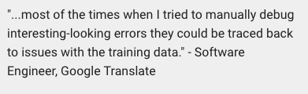
sayak.dev
Notes:
Most of the exciting as well as challenging things at Google Translate are connected to the training dataset like other machine learning-based projects all around the globe.

Slide 8
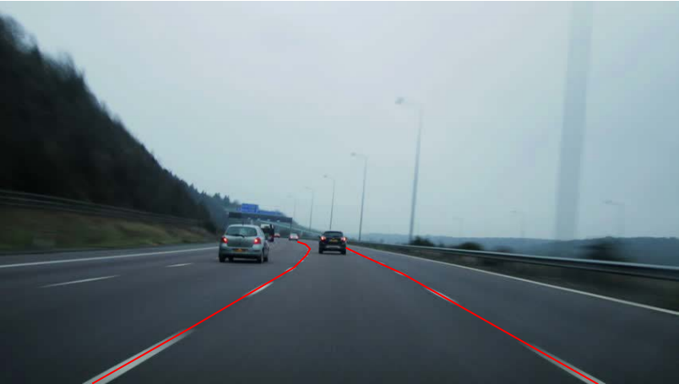
This is a sample from the training data
Lane detection in self-driving cars (Source)
sayak.dev
Notes:
And just for fun!
This is Tesla, btw.

Slide 9
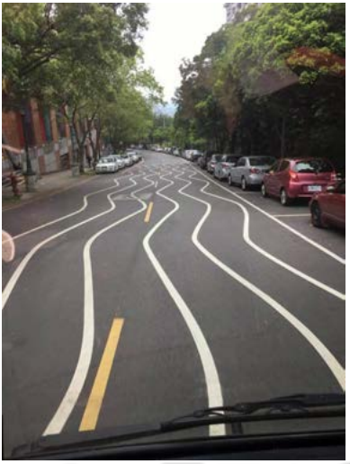
A sample during the time of inference!
Source
sayak.dev
Notes:
Now that we sort of agree that collecting good dataset important, let’s proceed to the next part.

Slide 10
The process of data preparation

Slide 11
Step 1: Collect raw data
Start with the problem statement
Identify input elements of the problem
Collect data that closely represents those elements
sayak.dev
Notes:
At this point, the project team should be thorough with the problem statement with regards to the inputs to the system, the outputs, the assumptions and so on.
I like to think of the raw data collection process in terms of these three major steps. We have already discussed the problem framing part. We will then need to specifically figure out the input modalities in the problem.
Consider this problem statement of recognizing handwritten characters. By recognition, we mean which handwritten character is what?
Clearly enough, the input here would be handwritten characters and our system needs to tell which character that is. We will restrict this to English only for simplicity. So, accordingly, we would collect images of handwritten English characters. No other input modality would be able to capture the handwritten part other than images. Fortunately, there is already a dataset which does this - the EMNIST dataset.

Slide 12
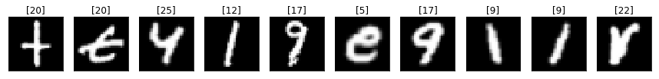
Step 1: Collect raw data
Start with the problem statement
Identify input elements of the problem
Collect data that closely represents those elements
Source
sayak.dev
Notes:
Okay, so, we have collected the raw data.
But how much data is required to get useful results? How do you measure your data set's quality and improve it?
Well, all of these depends on the problem being solved.

Slide 13
The size of a dataset
Your model should train on at least an order of magnitude more data points than trainable parameters
Simple models on large data sets generally beat fancy models on small data sets
sayak.dev
Notes:
As I mentioned, this is heavily dependent on the problem at hand. But here are some rules of thumb.
What are parameters, btw? Weights and biases are trainable parameters in neural nets. The things that a model learn during its training.
Then comes the question of complexity of models. If you can manage to accumulate large enough data, you could try to fit it with simpler models thereby reducing the computational costs.
This brings us to the next item in the menu.

Slide 14
The quality of a dataset
sayak.dev
Notes:
Let me give you an adage that applies to machine learning very strongly.

Slide 15
The quality of a dataset
“Garbage in, garbage out”
sayak.dev
Notes:
Your model is only as good as your data. But what counts as "quality"? It's a fuzzy term.
In terms of business perspectives, a quality data set is one that lets you succeed with the business problem you care about. In other words, the data is good if it accomplishes its intended task.
However, while collecting data, it's helpful to have a more concrete definition of quality. Certain aspects of quality is directly related to the better performance of models:

Slide 16
The quality of a dataset
Reliability
sayak.dev
Notes:
There are some points you should take care of when you are measuring the reliability of the data:
Is there any label noise in the data? For example, Shah Rukh Khan labelled as Salman Khan.
Are the features noisy? For example, GPS measurements fluctuate. Some noise is okay. You’ll never purge your data set of all noise.
Is the data properly filtered for your problem? Recall this from the previous slides.
You should also think very carefully if the data has:
Missing values
Duplicate values
Faulty features values
All these things collectively correspond to unreliability of a dataset. We then have -

Slide 17
The quality of a dataset
Reliability
Feature representation
sayak.dev
Notes:
Some questions to ask at this point:
How would the data get streamed to the model i.e. how would you map the data to useful features?
Is data normalization required?
How should you handle the outliers (if present)?
Finally -

Slide 18
The quality of a dataset
Reliability
Feature representation
Data leakage
sayak.dev
Notes:
It might so happen that a feature from the training set is not available during the prediction time and this can lead to a data leakage. A very common symptom of data leakage is having a very good performance during model training but very miserable during prediction.
Always remember that he more closely your training task matches your prediction task, the better your ML system will perform.

Slide 19
Step 2: Identify features and label sources
Notes:
We are now in the step 2 of the typical data preparation phase. We have the raw data. We now need to identify the features from the data and label them (we are only caring about supervised learning for now). Your ML system’s success has a lot to do with this. Let’s do this step by step.

Slide 20
Step 2.1: Identify features
Make a hypothesis about a feature(s), test it and then repeat
sayak.dev
Notes:
Pick 1-3 features that seem to have strong predictive power. It is always good to start simple and from here if you add in more features and see if the model performance improved or not.

Slide 21
Step 2.1: Identify features
Make a hypothesis about a feature(s), test it and then repeat
Identify the features such that data leakage is not introduced
sayak.dev
Notes:
We have already talked about data leakage and it’s worth spending time to ensure you are not introducing data leakage before putting the model into production.

Slide 22
Step 2.1: Identify features
Make a hypothesis about a feature(s), test it and then repeat
Identify the features such that data leakage is not introduced
Sometimes more features might lead to Curse of Dimensionality
sayak.dev
Notes:
Do you have sufficient number of data points to aid the features you have included? Consider, you have engineered 10 features but you only have 50 data points - your model will most likely end up with the curse of dimensionality.

Slide 23
Step 2.1: Identify features
Make a hypothesis about a feature(s), test it and then repeat
Identify the features such that data leakage is not introduced
Sometimes more features might lead to Curse of Dimensionality
Prediction data sources — online vs. offline
sayak.dev
Notes:
It’s also important for you to decide if the model predictions will be served online or offline:
online—Latency is a concern, so your system must generate prediction quickly.
offline—You likely have no compute restrictions, so can do similarly complex operations.
Consider the model is serving predictions online. If a certain feature value takes some time to compute, you should not consider that feature anywhere and look for alternatives.

Slide 24
Step 2.2: Label sources
Direct label vs. derived labels
sayak.dev
Notes:
Welcome to the heart of supervised learning - labels! Precisely, there can be two types of labels:
Direct labels - Is that a cat’s picture?
Derived label - A YouTube user has watched an Andrew Ng video (it does not directly measure what you want to predict). But does this mean the user likes watching Andrew Ng’s videos? Here, your model’s performance will be dependent on the connection between your derived label and your desired prediction.

Slide 25
Step 2.2: Label sources
Direct label vs. derived labels
Human labelling
sayak.dev
Notes:
Then, there is human labeling to consider when it is not straightforward to get direct or even derived labels - consider cancer images. Even if you have the labels from the data sources, it is worth doing some human labeling as it gives you a tremendous opportunity to know about the data.
Onto the next step -

Slide 26
Step 3: Select sampling strategy
Two situations:
Need to collect more data :(
Plenty of data, hence need to use a subset ^_^
sayak.dev

Slide 27
Step 3: Select sampling strategy
Two situations:
Need to collect more data :(
Plenty of data, hence need to use a subset ^_^
How do you do that? :O
sayak.dev
Notes:
Consider the problem of predicting tomorrow’s temperature. You would have a lot of past data for this problem. So, you might sample a subset from the available data. But would that sampling be random?
Well, not really! Here’s why -
We don’t really want our temperature forecasting model to predict the past temperature and if you randomly sample the data chances are that the past data would end up in the validation set.

Slide 28
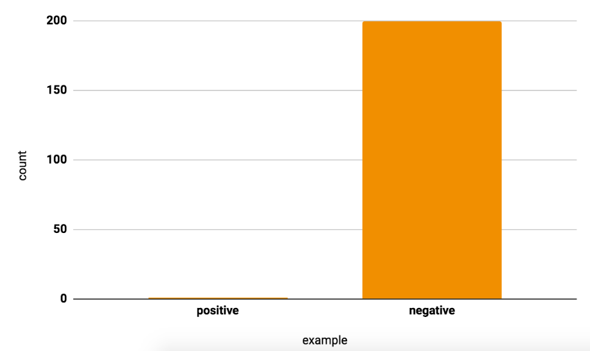
The problem of Class Imbalance
Source
sayak.dev
Notes:
Class imbalance, as you may already know is the problem where a certain class(s) dominates the other class(s) in a dataset. But why is this a problem exactly?
A human analogy - 4 additional problems and one subtraction problem. You end up seeing all are subtraction problems in the examination.
Let us now welcome the final step in the data preparation process -
I will not be able to discuss how to combat this problem due to time crunch. The idea was to bring this to your notice so that you do not miss out on this point while doing your analysis.

Slide 29
Step 4: Data splitting
Three golden splits:
Training
Validation
Testing
sayak.dev
Notes:
We have these three golden splits in machine learning.

Slide 30
Step 4: Data splitting
Two important questions:
When can we not split the data randomly?
When can we do that?
sayak.dev
Notes:
We often tend to split the data in random way. But what are some of the cases where this might not be ideal? We discussed this in an earlier slide.
When you splitting your dataset randomly make sure you shuffle the data points before that. This ensures your model is only learning from content of the data but not its order.
The splits should be such that they match the production time data as much as possible.

Slide 31
Incorporating fairness practices

Slide 32
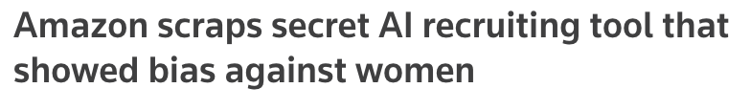
Why care about it?
sayak.dev

Slide 33
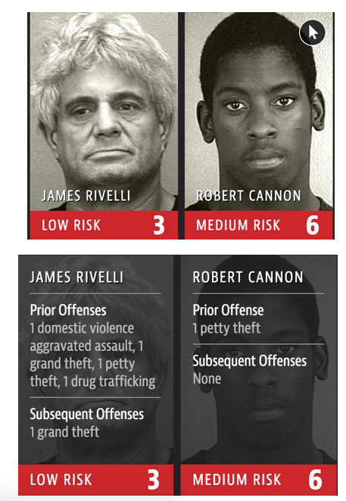
Why care about it?
sayak.dev

Slide 34
Why care about it?
And many more ...
sayak.dev
Notes:
So, the point is decisions must not be influenced by someone’s race, gender, sexual orientation and so on.

Slide 35
Combating bias
Identifying bias
sayak.dev
Notes:
To be able to fight the problem of bias, we need to first identify the bias in the dataset. Here are the three things to look out for in this regard -

Slide 36
Combating bias
Identifying bias
Missing feature values in large numbers
Unusual feature values
Class imbalance
sayak.dev
Notes:
Missing values in abundance leads to under-representation and this in turn can introduce bias.
There can be data points which may not conform to the characteristics of the rest of the data points present in a dataset. This can also introduce bias.
Now, comes the next one -
In case of the class imbalance problem, the issue of under or over-representation is introduced. Again, a source of bias!

Slide 37
Combating bias
Evaluating for bias
sayak.dev
Notes:
Once the bias is identified in the data, you need to figure out ways to evaluate your machine learning model along with the bias.

Slide 38
Combating bias
Evaluating for bias
Don’t fall prey to the accuracy paradox
Determine the confusion matrix of the model
Investigate the false predictions made by the model
sayak.dev
Notes:
Here are some ideas to evaluate a machine learning systems after you have identified that there’s bias in the data.
We often use accuracy as the only metric to evaluate the performance of our machine learning models. Consider a dataset having 100 data points out of which 99 are positive ones and only one is negative. Now, even if the model predicts all the 100 data points as positive ones, it still is 99% accurate. But what if you wanted to measure how good the model is at predicting the negative samples? This is a case, where only chasing accuracy won’t work.
This is where you would want to look at other metrics like precision and recall from the confusion matrix of the model. You can then start investigating the false predictions made by the model.
Although the list is very basic it serves as a good starting point.
Fairness in machine learning systems is another world unto itself. I have linked a good resource to study further about this topic in the references.

Slide 39
Wrapping up
The process of data preparation
Collect raw data
Identify features and label sources
Select sampling strategy
Data splitting
Incorporating fairness practices
sayak.dev
Notes:
We discussed several points to prepare data for machine learning. We started off with how to collect raw and we ended with a discussion on a basic fairness practices.
Here are some of the references I used to prepare this deck -

Slide 40
References
Data Preparation and Feature Engineering in ML
How (and why) to create a good validation set
Becoming One With the Data
Data Science from Scratch
Machine Learning Fairness
sayak.dev

Slide 41



See you next time
Find me here:
sayak.dev
Thank you very much :)
sayak.dev

